Slide 1




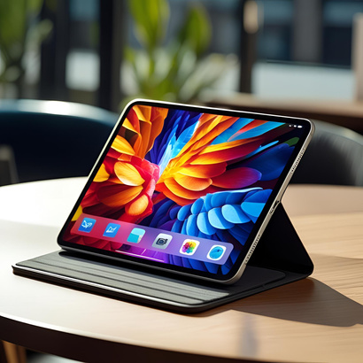
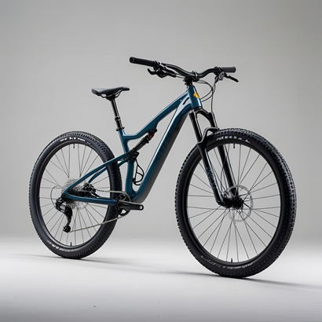

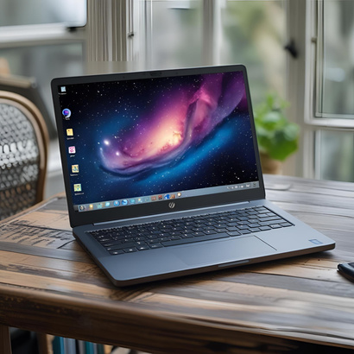


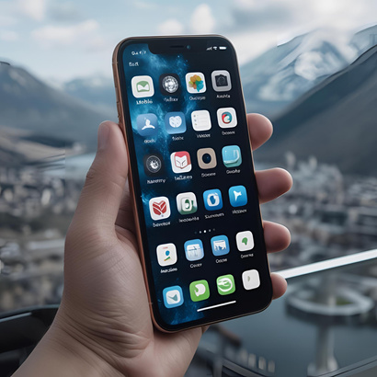

GOLD
INVESTOR IN ME CATALOGUE
95% + attendance
90%+ subject progress
90%+ IEP progress
1000+ behaviour points
90%+ MDT Engagement
90% + in PD
90%+ in Reading and Numeracy
£250
"
Tablet
Bike
VR Headset
Laptop
Voucher
Mobile
Item of your choice
You can do it!
Excellence from enrolment to Graduation

Slide 2


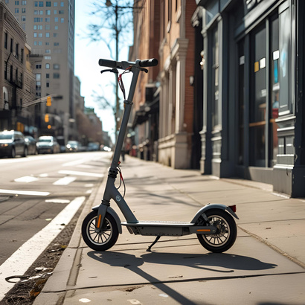

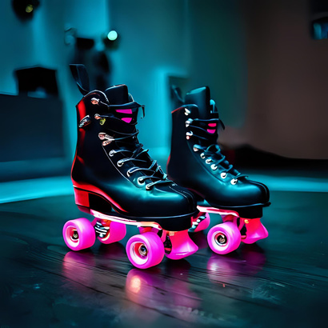

SILVER
INVESTOR IN ME CATALOGUE
90% + attendance
80%+ subject progress
1000+ behaviour points
80%+ IEP Progress
80%+ MDT Engagement
90% + in PD
85%+ in Reading and Numeracy
£150
"
Kindle
Scooter
Smart watch
Rollerskates
Voucher
Trainers
Item of your choice
You can do it!
Excellence from enrolment to Graduation

Slide 3

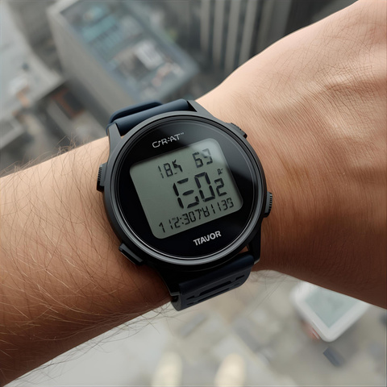
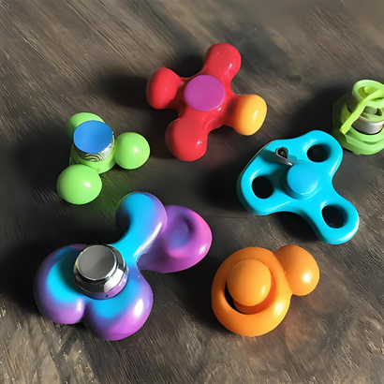
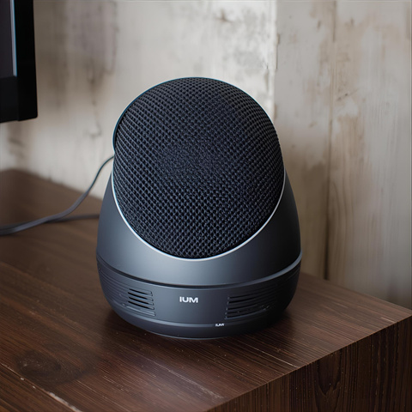


BRONZE
INVESTOR IN ME CATALOGUE
£50
Meeting attendance target
80%+ subject progress
1000+ behaviour points
Making IEP Progress
70%+ in Reading and Numeracy
"
Pedoometer
Fidget Toys
Wireless speaker
Books
Voucher
Headphones
Item of your choice
You can do it!
Excellence from enrolment to Graduation

