Slide 1



PRICE FRAMEWORK
Notes:
"Hello, and welcome to this presentation on the PRICE framework at Serenity School.
My name is Maurizio D'Alessio, and I am the Associate Assistant Headteacher for Behaviour for Learning.
This presentation has been created to help parents and carers understand our approach to supporting behaviour, keeping children safe, and promoting positive relationships. I'll explain what PRICE is, how we work to prevent incidents through effective support and de-escalation, and the very limited circumstances in which positive handling may be used.
I hope this presentation provides reassurance and a clear understanding of the values and principles that guide our practice every day at Serenity School."

Slide 2




Welcome!
We'll discuss:
What PRICE is
Our approach to behaviour
How we prevent incidents
What Positive Handling means
When physical intervention may be used
How we work with parents
Notes:
"During today's presentation we'll look at what PRICE stands for, our philosophy around behaviour, how we work to prevent incidents before they happen, what positive handling means, when physical intervention may sometimes become necessary, and finally how we work in partnership with parents throughout this process."

Slide 3

What is PRICE and what does it stand for?
PRICE stands for "Protecting Rights In a Caring Environment"
PRICE is a positive approach that focuses on:
Protecting everyone's rights
Promoting dignity and respect
Preventing situations from escalating
Supporting emotional regulation
Keeping everyone safe
Our goal is always prevention and de-escalation, not restraint.
Notes:
"PRICE stands for Protecting Rights In a Caring Environment.
It's a nationally recognised approach that places the child's rights, dignity and wellbeing at the centre of everything we do.
Our focus is always on preventing situations from escalating, helping children regulate their emotions, and creating safe environments where everyone can learn.
Physical intervention is never our starting point. Prevention and de-escalation are always our priorities."

Slide 4
Our Behaviour Philosophy
At Serenity we believe:
Behaviour is communication.
Children may communicate through behaviour when they are:
Anxious
Overwhelmed
Frustrated
Dysregulated
Unable to express their needs
Our role is to understand the reason behind the behaviour rather than simply react to it.
Notes:
"At Serenity School we believe that behaviour is a form of communication.
Children often communicate through their behaviour when they are anxious, overwhelmed, frustrated or unable to express what they need.
Our role is to understand the underlying reasons for a child's behaviour so that we can provide the right support, helping them to feel safe, regulated and ready to learn."

Slide 5
The PRICE approach
We always start with the least restrictive option.
Our priority is to:
✔ Build positive relationships
✔ Reduce anxiety
✔ Support emotional regulation
✔ Prevent incidents
✔ Keep everyone safe
Notes:
"Our approach always begins with the least restrictive option.
We invest time in building positive relationships because strong relationships reduce anxiety and increase trust.
By supporting emotional regulation and recognising early signs of distress, we can often prevent situations from becoming more challenging.
Everything we do is centred around keeping everyone safe while respecting the child's dignity."

Slide 6
Preventing Escalation
Most situations are resolved without physical intervention by using:
Calm communication
Giving processing time
Offering choices
Redirection
Distraction
Humour where appropriate
Reducing demands
Changing the environment
Sensory or regulation breaks
These strategies are known as de-escalation techniques.
Notes:
"Most situations are successfully resolved without any physical intervention.
Staff use a wide range of strategies such as calm communication, giving pupils time to process information, offering choices, redirecting attention, reducing demands, adjusting the environment, and providing sensory or regulation breaks.
These are all examples of de-escalation techniques that help children regain control in a safe and supportive way."

Slide 7
De-escalation Techniques
Examples include:
Speaking calmly
Giving personal space
Active listening
Reducing audience
Removing triggers
Offering reassurance
Allowing time to regulate
Using familiar staff
Encouraging coping strategies
Most incidents end successfully at this stage.
Notes:
"Every child is different, so the strategies we use are tailored to the individual.
This might include speaking calmly, giving personal space, actively listening, removing unnecessary triggers, reducing the number of people around the child, offering reassurance, or allowing time for them to regulate.
In the vast majority of situations, these approaches successfully prevent further escalation."

Slide 8
Pupil Behaviour Support Plans (PBSPs)
Every Student Has an Individual Pupil Behaviour Support Plan (PBSP)
Each PBSP is developed using information from:
The student's Education, Health and Care Plan (EHCP)
Professional reports and assessments
Information shared by parents and carers
Staff observations and ongoing assessments
The PBSP is a working document and is reviewed and updated regularly to ensure it reflects the student's current needs.
Notes:
"Every student at Serenity has an Individual Pupil Behaviour Support Plan, often referred to as a PBSP.
These plans are developed using information from Education, Health and Care Plans, professional reports, parent and carer input, and staff observations.
Importantly, they are living documents that are reviewed regularly as each child's needs develop."

Slide 9
What Does a PBSP Include?
Each plan clearly outlines:
The student's strengths and interests
Known triggers or situations that may cause distress
Early signs of anxiety or dysregulation
Preferred communication methods
Successful de-escalation strategies
Individual support and regulation strategies
Any agreed positive handling strategies (where appropriate)
Post-incident support and reflection
Notes:
"Each Behaviour Support Plan provides staff with detailed guidance about the individual child.
It highlights their strengths and interests, identifies known triggers, early warning signs of anxiety, preferred communication styles, successful de-escalation strategies, and any agreed support approaches.
Where appropriate, it may also include agreed positive handling strategies and guidance for supporting the child after an incident."

Slide 10
Why are PBSP'S important?
They help ensure that every member of staff:
Understands the individual child
Responds consistently
Uses strategies that are known to work
Promotes positive behaviour
Supports emotional regulation
Keeps everyone safe
Our aim is always to understand the individual behind the behaviour and provide support that meets their specific needs.
Notes:
"These plans ensure that every member of staff responds consistently and appropriately.
Consistency helps children feel secure and understood.
By knowing what works well for each individual child, we can reduce anxiety, promote positive behaviour, and support emotional regulation much more effectively.
Ultimately, our goal is always to understand the child behind the behaviour."

Slide 11
What is positive handling?
Positive Handling means:
Using the least restrictive intervention necessary to keep people safe.
It is:
✔ Planned
✔ Proportionate
✔ Reasonable
✔ Safe
✔ Recorded
✔ Reviewed
Notes:
"Positive handling simply means using the least restrictive intervention necessary to keep people safe.
Any intervention must always be carefully planned where possible, reasonable, proportionate, safe, fully recorded and reviewed afterwards.
It is never about controlling behaviour—it is about protecting everyone involved."

Slide 12
Physical Intervention is a Last Resort
Physical intervention is never used:
As punishment
To gain compliance
Because a child refuses work
To manage minor disruption
For staff convenience
It is only considered when absolutely necessary (Last Resort).
Notes:
"It's important to emphasise that physical intervention is never used as punishment.
It is never used because a child refuses to work, displays minor disruption, or for staff convenience.
It is only ever considered as a genuine last resort when other strategies have not been successful and there is a significant safety concern."

Slide 13
When Might Physical Intervention Be Used?
Physical intervention may only be used where there is an immediate risk of:
A child harming themselves
A child harming another person
A child causing serious damage to school property
Even then:
All appropriate de-escalation strategies must have been attempted first wherever possible.
Notes:
"There are very limited situations where physical intervention may become necessary.
These include occasions where there is an immediate risk of a child seriously harming themselves, harming another person, or causing serious damage to property.
Even in these circumstances, staff will have attempted appropriate de-escalation strategies wherever possible before considering any physical intervention."

Slide 14
The Principles We Follow
Any intervention must always be:
Necessary
Reasonable
Proportionate
In the child's best interests
For the shortest time possible
The child's dignity remains our priority throughout.
Notes:
"If physical intervention becomes necessary, there are clear principles that guide every decision.
The intervention must be necessary, reasonable, proportionate, and always in the child's best interests.
It should be used for the shortest possible time and the child's dignity must remain central throughout."

Slide 15
Staff Training
Our staff receive PRICE training which includes:
Behaviour understanding
Risk assessment
Communication
De-escalation strategies
Safe positive handling
How to record incidents
Reflection and learning
Training is regularly refreshed
Notes:
"Our staff receive comprehensive PRICE training.
This includes understanding behaviour, assessing risk, effective communication, de-escalation techniques, safe positive handling, recording incidents accurately, and reflecting afterwards to improve practice.
Training is refreshed regularly so staff maintain high standards and confidence."

Slide 16
After an Incident
Following any significant incident:
The child is supported emotionally.
Staff help the child regulate.
Parents are informed.
The incident is recorded.
Staff reflect on what happened.
Plans are updated if needed (PBSP and RA).
Our aim is always to reduce the likelihood of future incidents.
Notes:
"If a significant incident does occur, our work doesn't stop there.
The child's emotional wellbeing comes first, so we help them regulate and recover.
Parents are informed, the incident is recorded, staff reflect on what happened, and support plans are reviewed if changes are needed.
Every incident provides an opportunity to learn and reduce the chances of it happening again."

Slide 17
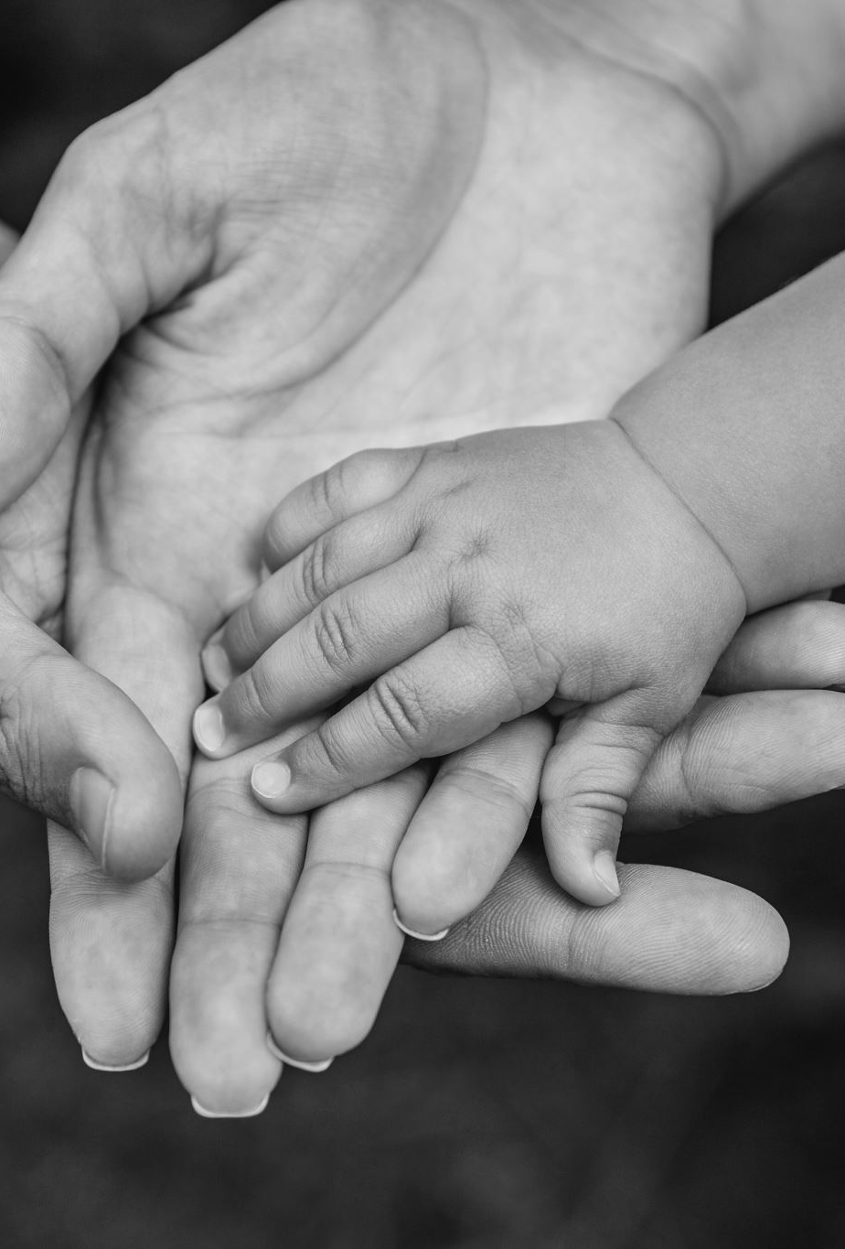
Working With Parents
Parents are key partners.
We will:
Share concerns early
Listen to your knowledge of your child
Develop support plans together
Communicate following significant incidents
Celebrate progress
Working together helps us achieve the best outcomes.
Notes:
"Parents and carers are vital partners in supporting children.
We believe the best outcomes happen when school and home work together.
We'll share concerns early, listen carefully to your knowledge of your child, involve you in developing support plans, communicate after significant incidents, and celebrate progress together."

Slide 18
Frequently Asked Questions
Will my child be restrained?
Only if there is an immediate risk of harm and all de-escalation techniques have been exhausted.
Will I be informed?
Yes, parents are informed following significant incidents involving physical intervention, in line with school procedures.
Is restraint used as punishment?
Never.
Notes:
"These are some of the questions we're asked most often.
Will my child be restrained? Only if there is an immediate risk of harm and every appropriate de-escalation strategy has been exhausted.
Will parents be informed? Absolutely. Significant incidents involving physical intervention are communicated in line with school procedures.
And finally, is restraint ever used as punishment? The answer is simply no—never."

Slide 19
Key Messages
Our priorities are:
❤️ Positive relationships
🧠 Understanding behaviour
🗣️ De-escalation first
🛡️ Safety for everyone
🤝 Partnership with parents
Physical intervention is always a last resort and is used only when necessary, reasonable and proportionate to keep everyone safe.
Notes:
"If there's one thing I'd like you to remember from this presentation, it's these key messages.
We prioritise positive relationships, understanding behaviour, and de-escalation before anything else.
We work to keep everyone safe while treating every child with dignity and respect.
Physical intervention is always a last resort and is only used when it is necessary, reasonable and proportionate."

Slide 20
Thank you!
Notes:
"Thank you very much for taking the time to listen today.
I hope this presentation has given you a clear understanding of the PRICE Framework and how we support children safely and compassionately at Serenity School.
If you have any questions or would like to get in touch, please feel free to contact me using the email address shown on the screen.
Thank you."

